Slide 1
Transatlantic Digital Historians Exhibit
By: Andrew Carruthers, Andrea Nikola Tonkovic, Dylan Nutbrown and Chelsea Rutherford
History 3801: Historian’s Craft
Dr. Bell
November 23rd 2016

Slide 2

The Harris Family

Slide 3
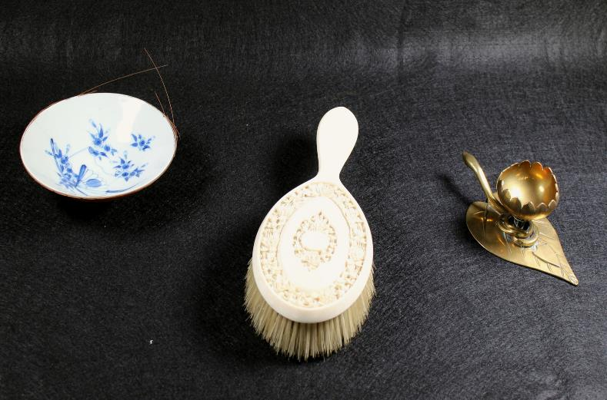
Our Objects:

Slide 4
The Objects:
Porcelain dish
Brush
Oil Dish

Slide 5
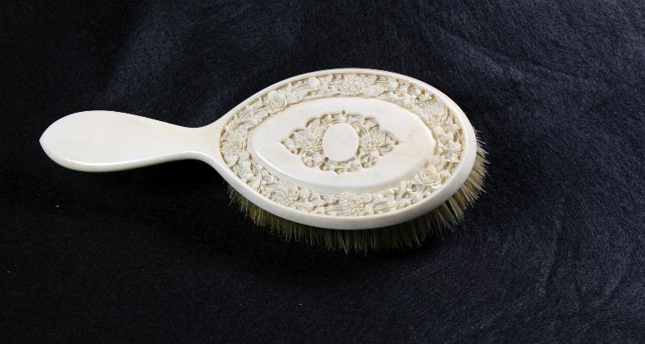
The Hair Brush

Slide 6
This hairbrush was purchased by the Harris family in Japan in 1897 on their world tour. The brush would have been part of a vanity set of the same pattern and design consisting of combs, other brushes and a mirror. The brush’s handle and back is made of a single piece of ivory. The brush would have been handmade and carved by Japanese craftsmen.

Slide 7
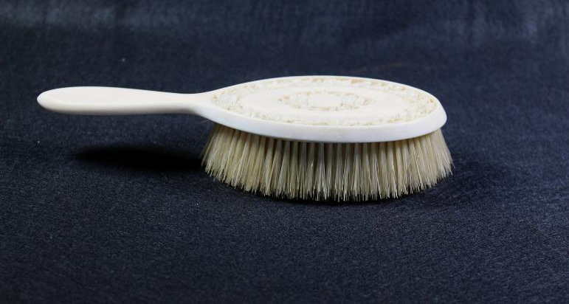

Slide 8
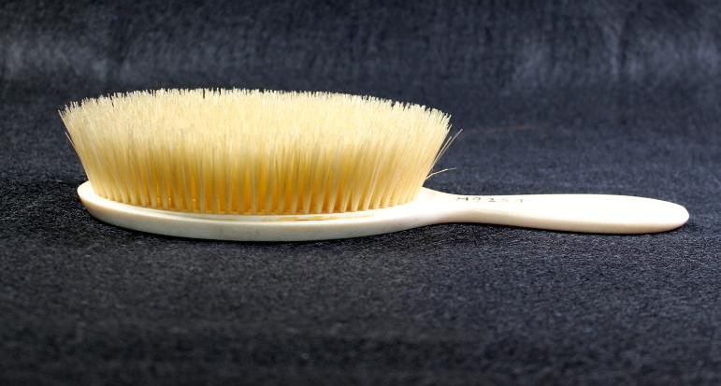

Slide 9
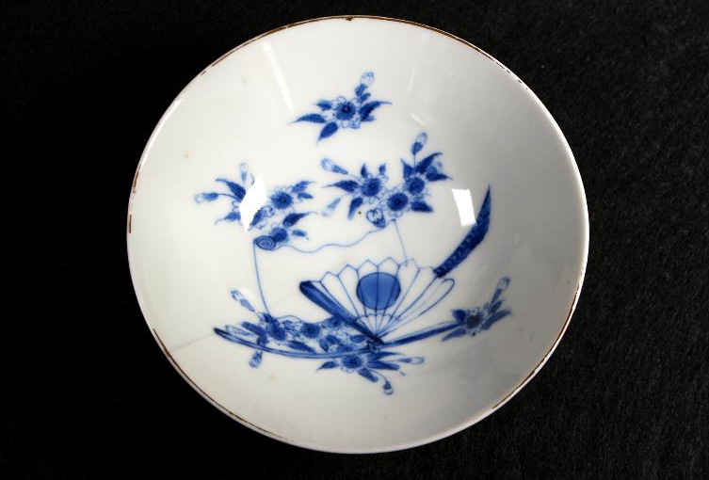
The Porcelain Dish

Slide 10
The porcelain is a unique piece from Japan as it is a piece that would have been owned by a wealthier patron but not designed for export like the ivory brush. The porcelain is very fine and is slightly transparent due to the materials used in its creation and likely has a much higher bone content than other duller pieces. The china dish has a blue and white floral pattern of the typical of the late 19th century.

Slide 11
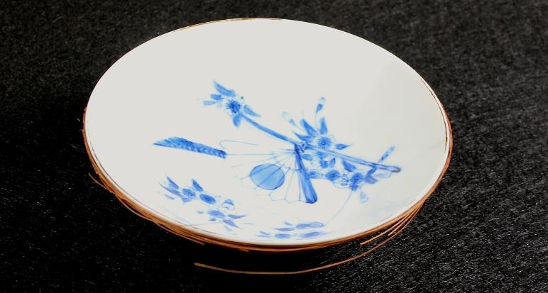

Slide 12
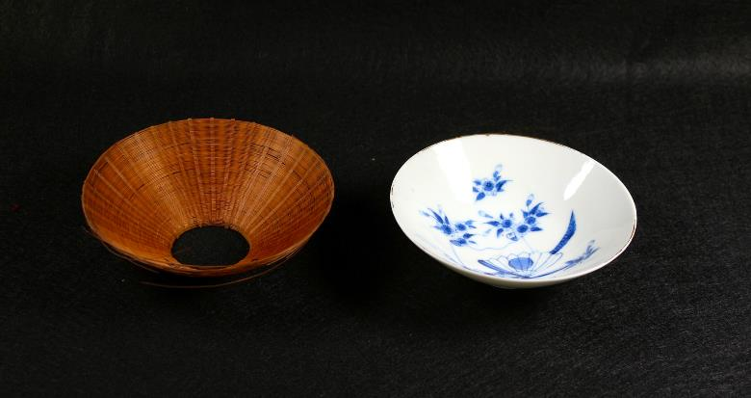

Slide 13
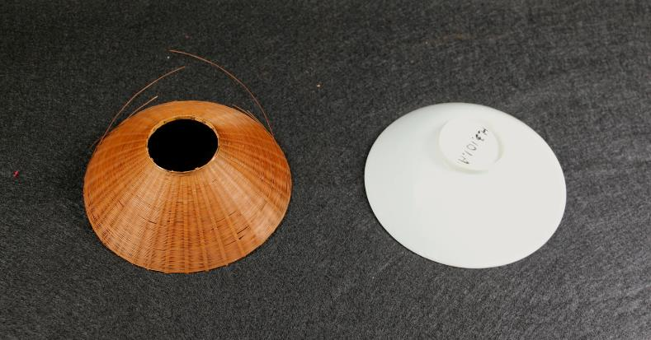

Slide 14
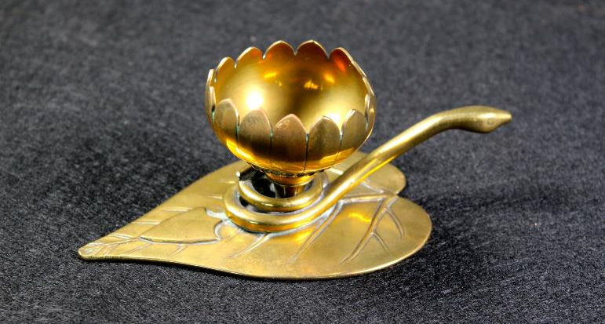
The Oil Lamp

Slide 15
This Oil Lamp is called a diya which is a lamp designed for ceremonial purposes. The diya is constructed in three different parts, the bottom or base, the middle, and the top. Each part of the diya is shaped and decorated to most likely represent a piece of cultural significance. The object is made of brass, which is a copper/zinc alloy.

Slide 16
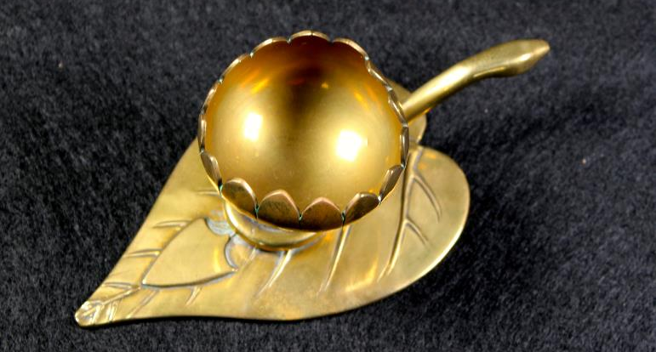

Slide 17
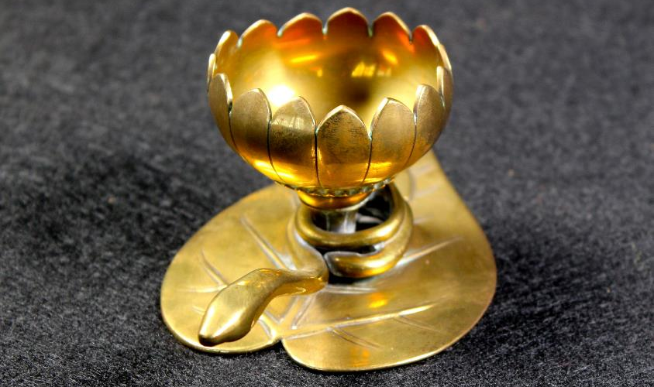

Slide 18
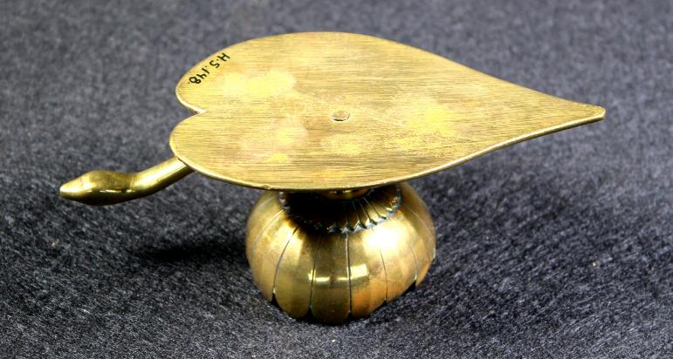

Slide 19
Bibliography
“The Family.” Eldon House. last modified 2016. http://www.eldonhouse.ca/eldon-house/the-family/
Wallace Janis. “It was a lived-in house.” The London Free Press. last modified January 23, 2010. http://www.lfpress.com/homes/news/2010/01/14/12470646.html
Von Glasenapp, Helmuth. Jainism: An Indian Religion of Salvation. Delhi: Motilal Banarsidass, 1999.
Berry, Thomas. Religions of India: Hinduism, Yoga, Buddhism. New York: Columbia University Press, 1996.
John Fuller, Christopher. The Camphor Flame: Popular Hinduism and Society in India. New Jersey: Princeton University Press, 2004.
Allocco, Amy. "Snakes, Goddesses, and Anthills: Modern Challenges and Women's Ritual Responses in Contemporary South India." University of Florida, 2009.
Fergusson, James. Tree and Serpent Worship: Or, Illustrations of Mythology and Art in India. New Delhi: Asian Educational Services, 2004.

Slide 20
… Continued
Gillette, Maris. "Copying, Counterfeiting, and Capitalism in Contemporary China: Jingdezhen’s Porcelain Industry." Modern China 36, no. 4 (2010): 367-403. doi:10.1177/0097700410369880.
Nagatake, Takeshi. Classic Japanese Porcelain: Imari and Kakiemon. Tokyo: Kondasha International, 2003.
Impey, Oliver. "Japanese Export Art of the Edo Period and Its Influence on European Art." Modern Asian Studies 18, no. 4 (1984): 685-97. http://www.jstor.org/stable/312344.
Finlay, Robert. "The Pilgrim Art: The Culture of Porcelain in World History." Journal of World History 9, no. 2 (1998): 141-87. http://www.jstor.org/stable/20078727.
D. Gihwala, L. Jacobson, M. Peisach, C. A. Pineda, and H. N. Vos. "Analysis of Chinese Porcelains and Ceramics." The South African Archaeological Bulletin 40, no. 142 (1985): 96-99. doi:10.2307/3888454.

Slide 21
… Continued
Marsh, Madeleine. Compacts and Cosmetics: Beauty from Victorian Times to the Present Day. Casemate Publishers, 2014. 48-52. ttps://books.google.ca/books?id=mkzWCwAAQBAJ&printsec=frontcover#v=onepage& q&f=false.
Nagatake, Takeshi. Classic Japanese Porcelain: Imari and Kakiemon. Tokyo: Kondasha International, 2003.
“The Family.” Eldon House. last modified 2016. http://www.eldonhouse.ca/eldon-house/the-family/
Von Glasenapp, Helmuth. Jainism: An Indian Religion of Salvation. Delhi: Motilal Banarsidass, 1999.
Wallace Janis. “It was a lived-in house.” The London Free Press. last modified January 23, 2010. http://www.lfpress.com/homes/news/2010/01/14/12470646.html

